Slide 1
Support Vector Machines

Slide 2
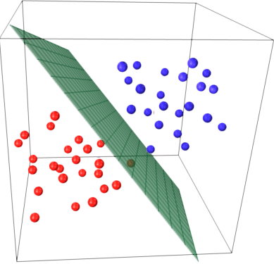
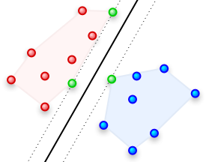
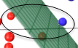
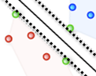
Support Vector Machines
Known as maximum-margin hyperplane, find that linear model with max margin. Unlike the liner classifiers, objective is not minimizing sum of squared errors but finding a line/plane that separates two or more groups with maximum margins
Max margin hyper plane
Margin
http://stackoverflow.com/questions/9480605/what-is-the-relation-between-the-number-of-support-vectors-and-training-data-and
Support Vectors

Slide 3
Perceptron
Perceptron Learning Algorithm –
Select random sample from training set as input. Draw the first random line (green) such that blue triangles lie above it and red circles ones below
If classification is correct, do nothing. But first time many blue triangles are on wrong side!
If classification is incorrect, modify the weight vector w and shift the green line
Repeat this procedure until the entire training set is classified correctly
Howsoever times we run this algorithm, it will find a surface which separates the two classes
Run 1
Run n

Slide 4
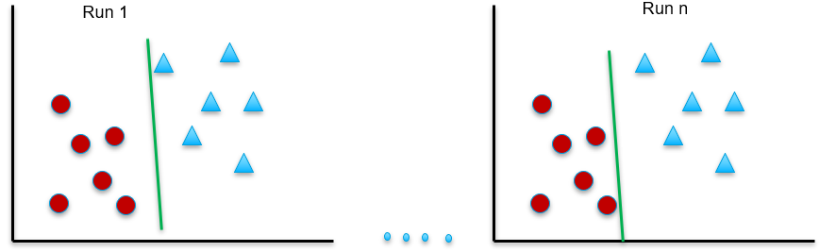
Test
Convergence theorem guarantees that when the classes are linearly separable in the training set, perceptron will find that surface which separates the two classes correctly
However, what we need is a perceptron which will correctly classify in test set. Not just training set
The perceptron algorithm does not guarantee it will be able to separate the two classes correctly even when the classes are linearly separable
Why? Because it does not look for an optimal plane. It stops the moment it finds the separator plane (a.k.a dichotomizer).
Since the planes, are passing very close to the data points in the training set, it may not perform well in test set where the distribution of the data will be different

Slide 5
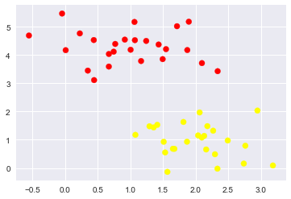
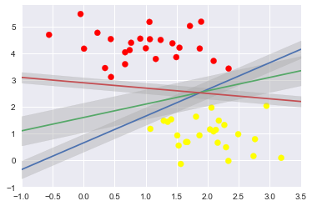
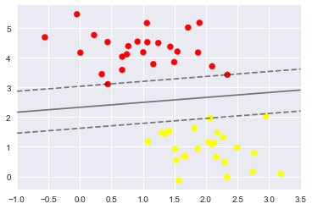
D
Formally the properties of data is
Given D = { (xi , yi) / xi E R^n , yi E {-1 , +1}} for i = 1 to m Note “E” means “belongs to”
Given xi, yi in a data set D, xi being defined with real values in “n” dimensions, corresponding
yi (label) is assigned value -1 for data belonging to one class and +1 to data belonging to\
the other class
With the formal definition of the data, the objective is to find a plane which will segregate the two classes such that all -1 lie on one side and all +1 lie on the other and keep maximum margins on both sides (to ensure it performs equally well in unseen data)
Yi = +1
X2
Yi = -1
X1
Ref: SVM_concepts.ipynb

Slide 6
Support Vector Classifier– OCR
Handwritten character recognition
Description – Sample data is available at local file system as Letterdata.csv
The dataset is described at https://archive.ics.uci.edu/ml/datasets/letter+recognition
Sol: SVM_OCR.ipynb

Slide 7
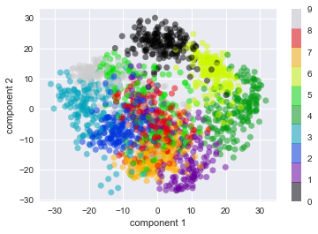
Support Vector Classifier– Digit Recognition
Description – Sample data is sklearn
Sol: SVM_digit_recognition.ipynb
Multi_class Classification –
http://vision.stanford.edu/teaching/cs231n-demos/linear-classify/

Slide 8
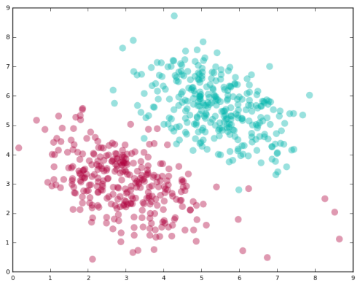
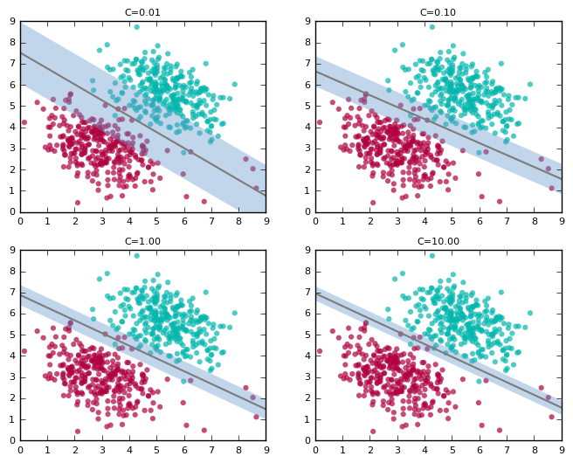
Support Vector Machines Soft Margins
Image Source : https://dzone.com/articles/support-vector-machines-tutorial
Data in real world is typically not linearly separable.
There will always be instances that a linear classifier can’t get right
SVM provides a complexity parameter, a tradeoff between: wide margin with errors or a tight margin with minimal errors. As C increases, margins become tighter

Slide 9
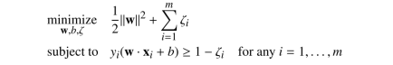
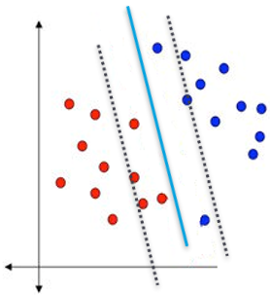
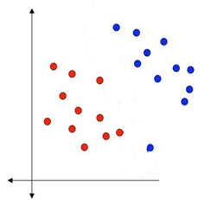
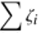
SVM For linearly separable data (Soft Margins)
The optimization problem is changed to
A slack variable is introduced which allows data points to be on the wrong side of the margins.
The slack for a data point is magnitude of the violation from respective margins.
Slack for data points on the correct side of the margins = 0
Objective is to minimize overall sum of slack across all data points
A cost hyper parameter ‘C’ is used to control the softness of the margins
> 0

Slide 10
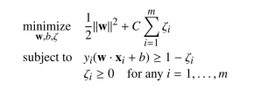
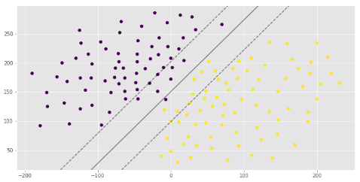
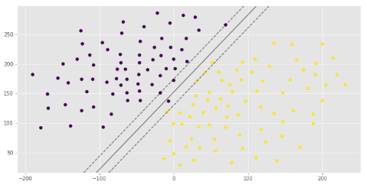
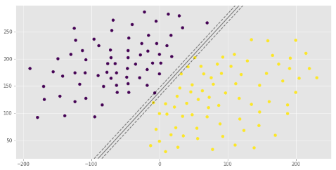
Support Vector Machines Soft Margins
To give user a control over the slack variable while building a model, another term ‘C’ is introduced and the optimization looks like
‘C’ helps us decide how important the slack is. C=0 means no constraint , When ‘C’ is high , stricter the margins
Increasing cost C / increase in training score / prone to variance error
Image Source :https://mubaris.com/posts/svm/
Decrease in cost C / increase in tolerance/ generalize well/ increase bias error

Slide 11
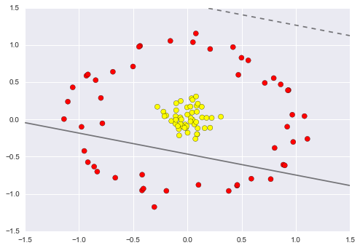
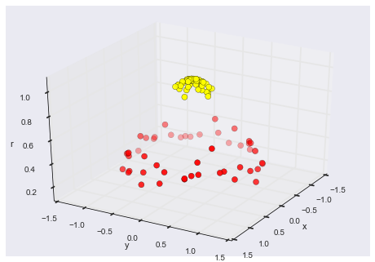
Support Vector Machines Linearly Non Separable Data
Ref:SVM_concepts.ipynb
When data is not linearly separable, SVM uses kernel trick to make it linearly separable
This concept is based on Cover’s theorem “given a set of training data that is not linearly separable, with high probability it can be transformed into a linearly separable training set by projecting it into a higher-dimensional space via some non-linear transformation”

Slide 12
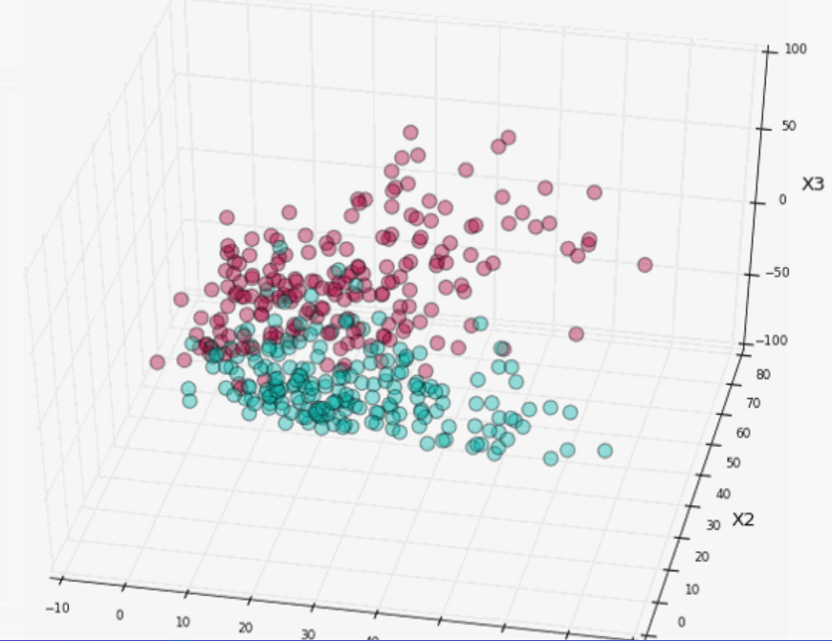
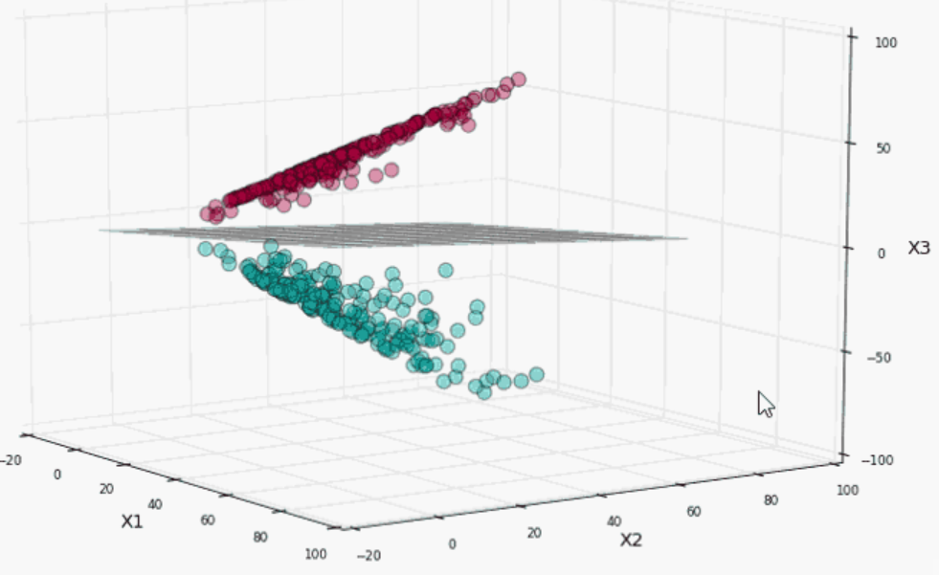
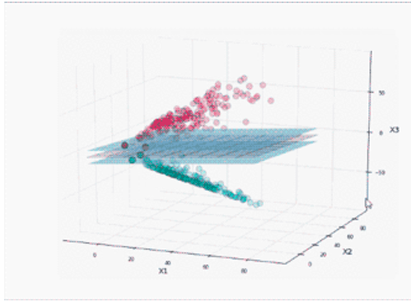
Support Vector Machines Linearly Non Separable Data
Image Source : https://dzone.com/articles/support-vector-machines-tutorial
Using kernel tricks the data points are project to higher dimensional space
The data points become relatively more easily separable in higher dimension space
SVM can now be drawn between the data sets with a given complexity

Slide 13
Machine Learning (Support Vector Machines - Kernels)
Kernels is a way of computing dot product of two vectors (how much they influence each other and net result) in some higher dimensional space.
That is why Kernels are also known as generalized dot products
Cover’s theorem shows that the chances of linearly non-separable data sets becoming linearly separable increase in higher dimensions
Apply the transformations and use Kernel functions to find the dot products to solve the SVM constrained optimization

Slide 14
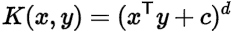
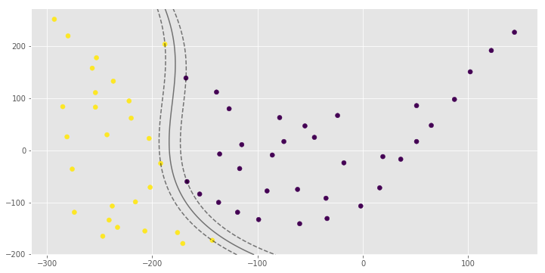
Support Vector Machines Kernel Functions
SVM libraries come packaged with some standard kernel functions such as polynomial, radial basis function (RBF), and Sigmoid
For degree-d polynomials, the polynomial kernel looks like where x and y are input vectors in lower dimension space, c is a user specified constant (usually 1). K denotes inner product of x,y in higher dimension space
Image Source :https://mubaris.com/posts/svm/

Slide 15

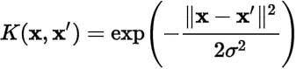
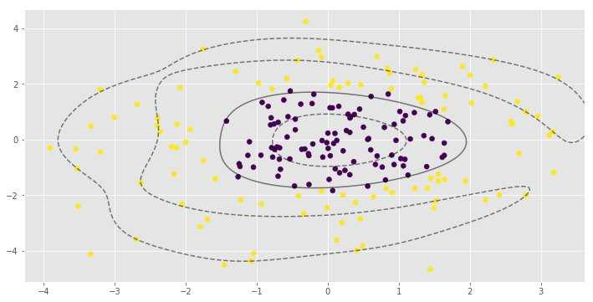
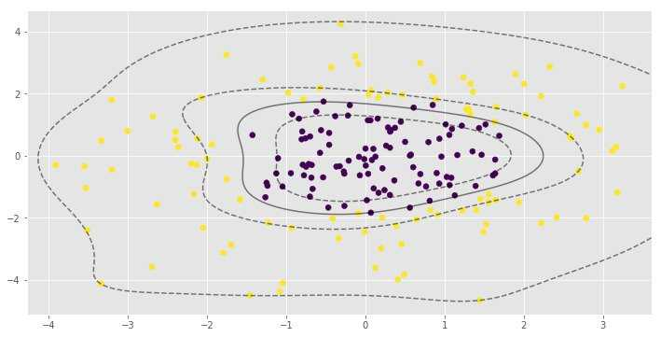
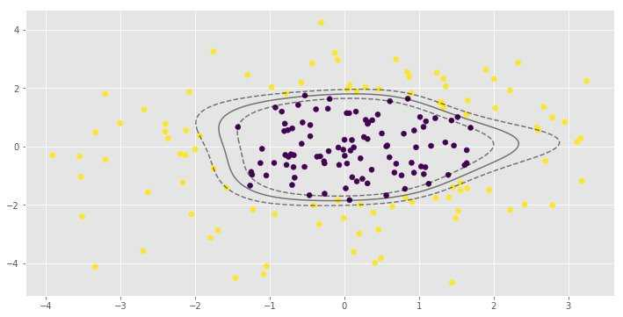
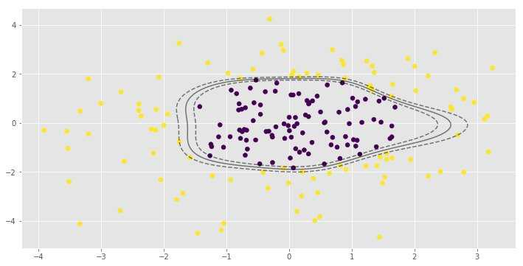
Support Vector Machines Kernel Functions
RBF (Radial Basis Function) kernel on two samples x and x’ is represented as -
It ranges from 0 when distance between x and x’ increases (e^-infinity becomes 0) and becomes 1 when x = x’ because x – x’ = 0 and anything raised to 0 is 1
Image Source :https://www.hackerearth.com/blog/machine-learning/simple-tutorial-svm-parameter-tuning-python-r/
Increasing cost C / increase in training score / prone to variance error
Decrease in cost C / increase in tolerance/ generalize well/ increase bias error
Image Source :https://mubaris.com/posts/svm/

Slide 16
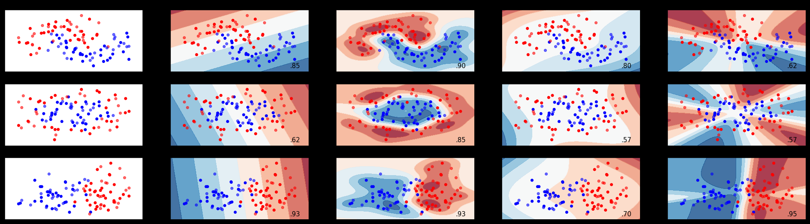
Support Vector Machines Kernel Functions
Sigmoid Kernel looks like
Linear Kernel are of the form that represents linear equation
K(X,Y)=tanh(γ⋅X(transpose)Y+r)
Feature space
Linear Kernel
RBF Kernel
Polynomial Kernel
Sigmoid Kernel
Source: https://gist.github.com/WittmannF/60680723ed8dd0cb993051a7448f7805

Slide 17
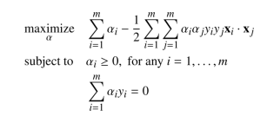
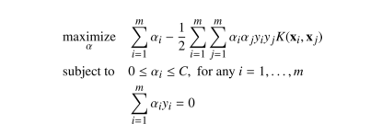
SVM Kernel tricks for higher dimensional analysis

Slide 18
Machine Learning (Support Vector Machines)
Strengths | Weakness
Very stable as it depends on the support vectors only. Not influenced by any other data point including outliers | Computationally intensive
Can be adapted to classification or numeric prediction problems | Prone to over fitting training data
Capable of modelling relatively more complex patterns than nearly any algorithm | Generally treated as a blackbox model
Makes no assumptions about underlying data sets

Slide 19
Support Vector Classifier– Bank Note Authentication

Slide 20
Thank You

Slide 21
Geometrical / mathematical approach to SVM

Slide 22
Geometry and maths behind SVM
The line makes all blue data points +1 and red ones -1
Substitute (2,2) i.e. red in the equation (2 + 1*2 -5) returns – number
Similarly substitute 5,3 (blue) , ( 5 + 1*3 – 5) returns positive value.
All on right side are + and left –ve. A correct classification but the line is passing too close to data points!
There are infinite lines(each corresponding to a small change in the slope) possible that can cleanly separate the two classes of data points
y+1x – 5 = 0

Slide 23
The problem is how do we find out the best / optimal plane from the infinite!
We need a way to compare the different planes. We have already seen that when we substitute the coordinate values of a datapoint in the equation, we get a positive or negative number.
When we substitute the coordinates of the points into the equation of a line such as ( y + 1x – 5 = 0), we get back a positive or negative number. In the pic below the farthest blue and red points are (7,6) and (1, 2) with returned value of 8 and -2 respectively
All data points will return a number whose magnitude will be greater than zero except when the point is on the line. Thus we can treat the returned number as a distance of the point from the line
y+1x – 5 = 0

Slide 24
Often line or a plane is represented as y = mX + b. This representation is useful when ‘y’ is dependent on (influenced by) the value of X and we wish to represent the relation between ‘y’ and ‘X’ i.e the pattern in form of a equation
‘y’ is the dependent variable whose value depends on the values of ‘X’, ‘m’ and ‘b’
‘m’ is called a slope / coefficient or a collection of slopes / coefficients. (we will call it slope)
‘b’ is the intercept (value of ‘y’ when all coefficients are zero)
‘X’ represents the independent variables that impact value of ‘y’
In classification, we do not have any dependent variable with continuous value that we need to predict. Instead we have classes with data points scattered in the feature space. So, where is the pattern?
We started by assuming the classes are linearly separable! That means the space separating the data points from the two classes has a linear shape, a linear pattern (yellow space). It is that pattern we are trying to capture in form of a linear equation. Thus the axis in the feature space are all independent variables.

Slide 25
By adjusting their slopes we are trying to find a line that represents the separating space.
The slope is also represented by a normal vector (black arrow which is always perpendicular to the line)
The normal vector is usually represented as a vector from the origins, here it is shown on the respective line itself
In the animation the slope of the yellow line is negative
As the line becomes more and more parallel to horizontal axis, the magnitude of the normal vector becomes 0
As the line becomes parallel to the vertical axis, the magnitude of the normal vector becomes infinite

Slide 26
Every data point can also be considered as a vector, a data vector
Data vector (blue and purple arrows) originates from the origin as does the slope vector w (black) of the line (1y+1x-5=0)
When we substitute value of the data point (4,6) into the equation of the line, we are doing a multiplication a.k.a dot product that results in a number … 1*6 + (1*4) – 5 = 5.
Dot products are calculated using matrix algebra where data vector and slope vector are stored in separate matrices
The dot product is shown as wT * X. Here X = (4,6) and w = (1,1), a row. wT (is transpose of w matrix which is a column
Thus the entire operation becomes wT * X – 5 = 5 for blue data vector. For the purple data vector (3,1), wT * X – 5 = 1*1 + 1*3 – 5 = -2
For data points lying exactly on the line, e.g. (1, 4), the dot product will return 0
dot product uses slope vector to rescale the data vector and gives the vertical distance between a parallel line through the scaled point and the given line
1y+1x – 5 = 0
X
wT
6
4
1
1
dot
wT
1
1
6
4
*
10

Slide 27
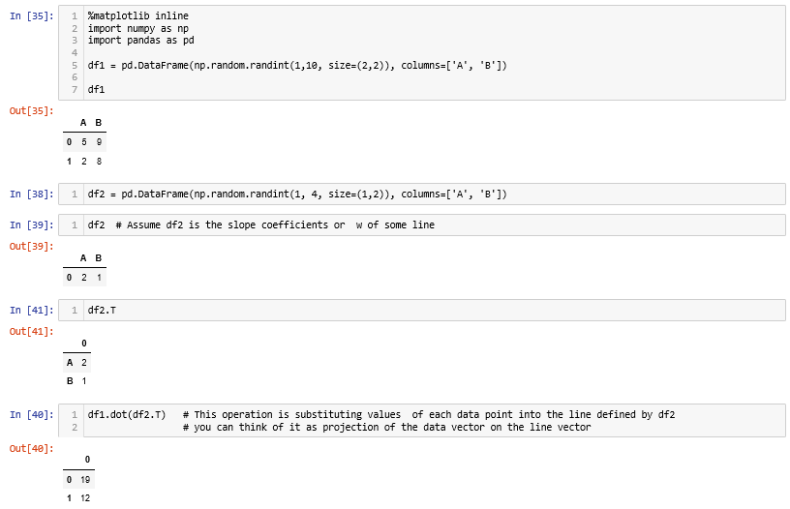
Note: the numbers are not truly distance of the point from the line. They cannot be represented geometrically. We only take them as functional margin i.e. margin from a functional calculation

Slide 28
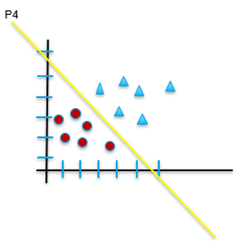
Now we have a way of comparing the planes. Planes can be arranged in descending order of the distance from the nearest point (min distance). Note: a data point with -5 is physically farther away from line than say a point with -2. We wish to pick -2 as min distance not -5. Hence we go for magnitude.
The plane with max of min distance (P4) from the nearest point is the most optimal plane. This plane is likely to perform relatively better than other planes
The distance between nearest data point and a plane is called margin of the plane which is the least of yi(yi -mXi +b) where i ranges from 1 to n (number of data points)
The equation of line is multiplied by label value (yi) to ensure right plane is selected when going for magnitude based distance. This is called functional margin of the plane due to the point (Xi, yi) which is closest.
The challenge is, we can have infinite planes and millions of points to evaluate each on… Brute force method may take age of the universe to find the most optimal plane
P2
P3
Plane | Ranked on descending order of distance from nearest point
P4 | D4
P2 | D3
P3 | D2
P1 | D1
P1

Slide 29
Given the optimal plane is maximally separated from the data points from the two classes, we can look at the situation as shown
The objective thus is to find a plane which has maximum functional margins. Margin is a no-man’s land. No data points should be inside the margin (hard margins).
However, while comparing the planes, we know that line (1*y+(1* X -5) = 0) is same as line (10*y + 10*X – 50 = 0) is the same as (100*y + 100*X – 500 = 0)… i.e. all lines can be represented at different scales. The algorithm should not waste time comparing a plane to itself!
To prevent the algorithm from unnecessarily evaluating same line at different scales, we restrict it to evaluate only that plane whose slope vector is unit length. Divide slope vector w and the intercept in the equation by the magnitude of the slope vector
Magnitude of a slope vector w is represented as ||w|| (magnitude a.k.a norm of the vector). ||w|| is derived using Euclidian formula Sqrt( W1^2 + W2^2) where W1 and W2 are the length of the vector projection on dimension x1 and x2. Suppose we take 10*y + 10*X – 50 = 0. ||w|| = sqrt(10^2 + 10^2) = 10.
Thus 10*y + 10*X -50 = 0 ➔ 10/||w|| *y + 10/||w||*X - 50 / ||10|| = 0 ➔ 1*y + 1*X – 5 = 0 (unit vector line)

Slide 30
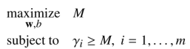
Thus the expression for the functional margin of a point becomes yi(yi*1/||w|| + Xi*w/||w|| - b/||w||)
This is called geometric margin of a point as it can be derived geometrically. GM = F / ||w|| (F is functional margin)
The objective now is to find a plane in terms of w and b which has maximum geometric margin given the data points
To find the w and b we need to max geometric margin M with respect to w and b with the constraint that mi (distance of point i from the plane) for each data point is greater than or equal to M
P2
P3
P1
The constraint will help find the point of least distance for the plane defined by w and b
Since GM = FM / ||w||, for a given w, the constraint is fi > F where fi is functional margin of each point and F contains the least distance
In simple terms, this is like a for next loop for I = 1 to n where if fi < F, replace F with fi else next i. This will pocket the least fi eventually before the loop is over.
Let this least fi stored in F be 1 unit.

Slide 31
Thus, the objective now is to maximize 1/||w|| with respect to w, b (across all possible planes) with the constraint that fi > 1, for all data points i = 1 to n
This is equivalent to minimize ||w|| with respect to w, b subject to yi(w.xi) + b >= 1 for i = 1 to n
Let the first line be P2 (w2, b2), min distance be 0.5. Let this be 1 unit. The next best plane will be the one for which the functional margin of all data points will be greater or equal to 0.5. Note we do not want a plane whose functional margin is less than 0.5… such plane will not be better than P2. We want a plane which is better than P2
In the next loop, suppose we find P1 (w1,b1). We find that at least one red data point is much close than P2 GM. Thus we stop evaluating this plane and move to next one
Instead of finding the least margin in P1 and then comparing the min distance of P1 with min distance of P2, compare the functional margins of every data point from P1 to min functional margin of P2
Replace GM with min functional margin of P1 if it is greater than that of P2
Repeat the steps 59 - 61 till we find the plane with max margins
P2
P3
P1

Slide 32
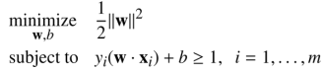
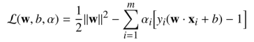
The objective function can now be represented as min ½(||w||^2 with respect to (w,b) subject to the condition that functional margin of all data points i =1 to n, yi(w.xi) + b >=1 for subsequent planes
The factors of ½ and square term are included to make later calculations easier
This is convex quadratic optimization problem. Easier to solve than the original constraints
Here we introduce Lagrangian function which combines the two problems into one unconstrained problem
A new term (Lagrangian multiplier) represented by alpha is introduced for each data point. The multiplier can be considered as a weight associated with each point
To solve the Lagrangian expression we need to minimize with respect to “w,b” and maximize with respect to alpha

Slide 33
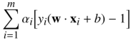
Wolfe Dual Problem – The lagrangian has m inequality constraints where m is number of data points in the data set. Such problem is typically solved using it’s dual form
The duality principle says that this problem can be viewed in two perspectives. First is the primal, a minimization in this case and the other one is maximization which is dual in this case
The max of the dual will always be less than the min of the primal. It sets a lower bound to the solution of the primal
In the case of SVM, the minimization problem (primal problem) is convex (quadratic and hence a global minima guaranteed) and the primal problem is affine ( a linear equation)
Given that, Slater’s conditions says that the maximum of dual will be equal to minimum of primal i.e. both solutions will be the same (Strong Dual case)
minimize
W^2
maximize
Wp

Slide 34
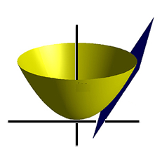
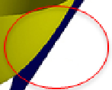
Lagrange Method for Function Optimization
When faced with a situation where we need to find the local minima/maxima of a function subject too constraints (i.e. restrict the region in MS within which to look for), Guiseppe Lodovico Lagrangia a.k.a Joseph Loui Lagrange, invented a strategy of finding such local maxima and minima in a non-parameterized way. This method is called Lagrange Multiplier
When we try to solve an optimization problem of the form – minimize f(x) given x subject to condition g(x) = 0, Lagrange noticed that the minimum is found at that value of x where the gradient point in the same direction for both f(x) and g(x)
Gradient is a vector i.e. combination of direction and magnitude. In our minimization and constraint function it can be shown as
W^2
W^2
Wherever the gradient vectors become same in direction and magnitude. Technically gradient vectors is shown on input space. Here the blue and red arrow (slope vectors) are showing the point where gradient is same for both plane and the convex function
W2 optimal
W2 optimal
W1
W1 optimal
W1
W2

Slide 35
SVM Mechanism
Lagrange noticed that the min of first is found when gradient vector points in same direction as gradient of g. In other words
Note, the gradient vector is shown as golden and black arrows on the base of the weight space. Both are pointing is same direction
Therefore we have to solve the problem
The gradient of the two functions could be as shown in next slide

Slide 36
SVM Mechanism
In the case of SVM, the minimization problem (primal problem) is convex (quadratic and hence a global minima guaranteed) and the primal problem is affine ( a linear equation)
Given that, Slater’s conditions says that the maximum of dual will be equal to minimum of primal i.e. both solutions will be the same (Strong Dual case)
minimize
To solve the primal, we use the familiar partial differential based approach on the Lagrangian
W^2
GM
Wd = Wp
maximize
Wp
Note: The minima of the primal in the solution may not be global minima

Slide 37
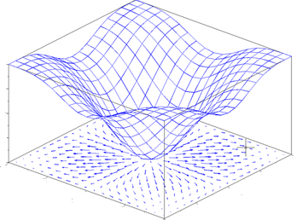
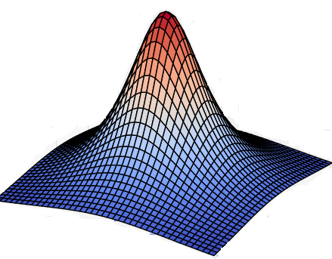
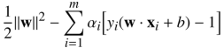
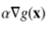
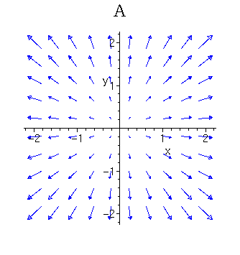
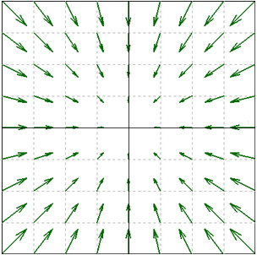
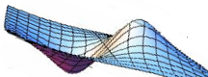
SVM Mechanism
Combination of w and b where gradient of both minima and maxima point in same direction
The Lagrange variable alpha

Slide 38
SVM Mechanism
To solve the primal, we use the familiar partial differential based approach on the Lagrangian. The optimization problem takes a form -
This expression becomes important for us to understand another concept called Kernel tricks used by SVM!

Slide 39
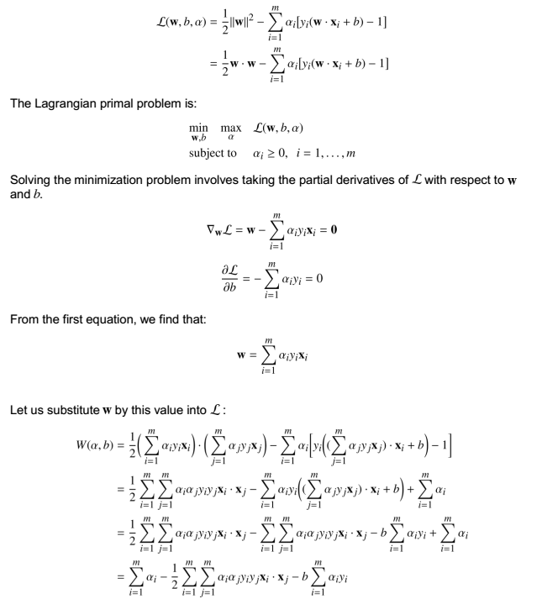

SVM Mechanism
Lagrangian
The dual form
Partial derivative of the lagrangian
1

Slide 40



Gradient Descent
Transform our error function (which is a quadratic / convex function) into a contour graph. Gradient is always found on the input model parameters only
Every ring on the error function represents a combination of coefficients (m1 and m2 in the image) which result in same quantum of error i.e. SSE
Let us convert that to a 2d contour plot. In the contour plot, every ring represents one quantum of error.
The innermost ring / bull’s eye is the combination of the coefficients that gives the lease SSE
Bias
weight

Slide 41

Randomly selected starting point
About the contour graph –
Outermost circle is highest error while innermost is the least error circle
A circle represents combination of paramters which result in same error. Moving on a circle will not reduce error.
Objective is to start from anywhere but reach the innermost circle
B1
W1
Bias
weight
Gradient Descent Steps –
First evaluate dy(error)/d(weight) to find the direction of highest increase in error given a unit change in weight (Blue arrow). Partial derivative w.r.t. to weight
Next find dy(error) /d(bias) to find the direction of highest increase in error given a unit change in bias (green arrow). Partial derivative w.r.t. to bias
Partial derivatives give the gradient in the given axis and gradient is a vector
Add the two vectors to get the direction of gradient (black arrow) i.e. direction of max increase in error
We want to decrease error, so find negative of the gradient i.e. opposite to black arrow ( Orange arrow). The arrow tip is new value of bias and weight.
Recalculate the error at this combination an iterate to step 1 till movement in any direction only increases the error
Gradient vector

